Slide 1
Cloud Native Development-Using IBM Cloud Pak for Applications Session 3 – 12th May 2020
IBM Cloud Registration -
https://bit.ly/cloudreg12may
JOIN SLACK FOR SUPPORT –
https://bit.ly/infyslack
Already signed in Developers – Q&A Session channel link
https://bit.ly/slackinfosys

Slide 2
Agenda
10:00:am – 10:05 am | Introduction and General Information sharing | Shivanand Shenoi
10:05:am - 10:50am | OpenShift using Source2Image, Deployment Config, Routes, and Image Streams | Mangesh Patankar
10:50am - 11:00am | 10 mins break
11:00am - 11:50 am | Source to image Lab | Ishani Pandey
11:50am - 12:00pm | 10 mins break
12:00 pm - 12:30 pm | CI/CD patterns on OpenShift (Jenkins, Tekton) | Ritu Maheshwari
12:30pm - 12:45pm | Q&A

Slide 3
OpenShift : Deploying to OpenShift — Developer Advocate Teck talk : Mangesh Patankar

Slide 4
Agenda
Quick Recap
OpenShift – Deployments
OpenShift deployment - As a set of layers
Deployment
Deployment Config
History
Rollback
Deployment Strategies – Recreate, Rolling Upgrade
Advance Deployment Strategies - A/B, Blue Green
Hands on

Slide 5
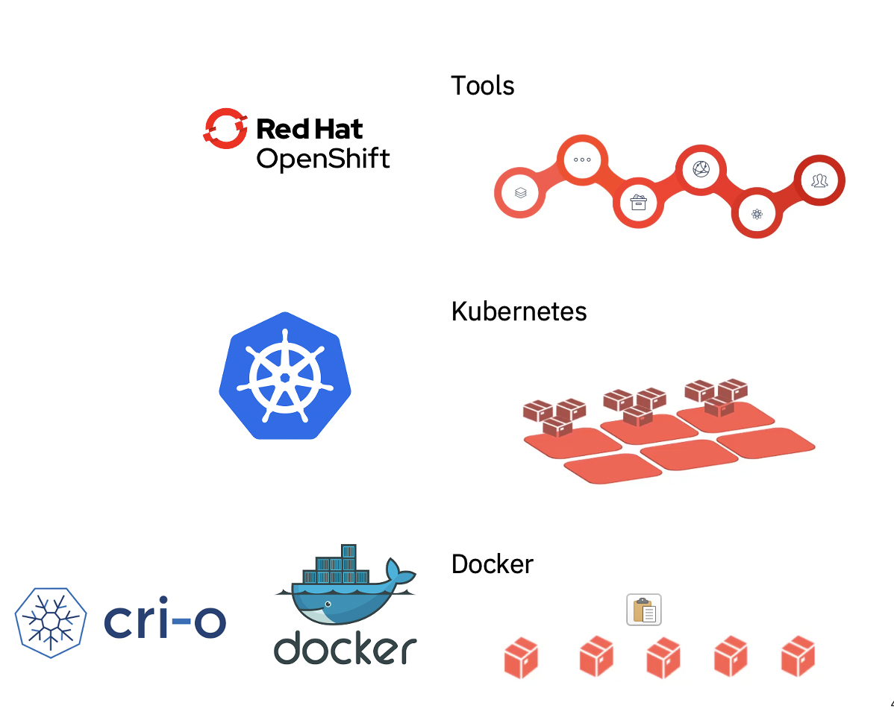
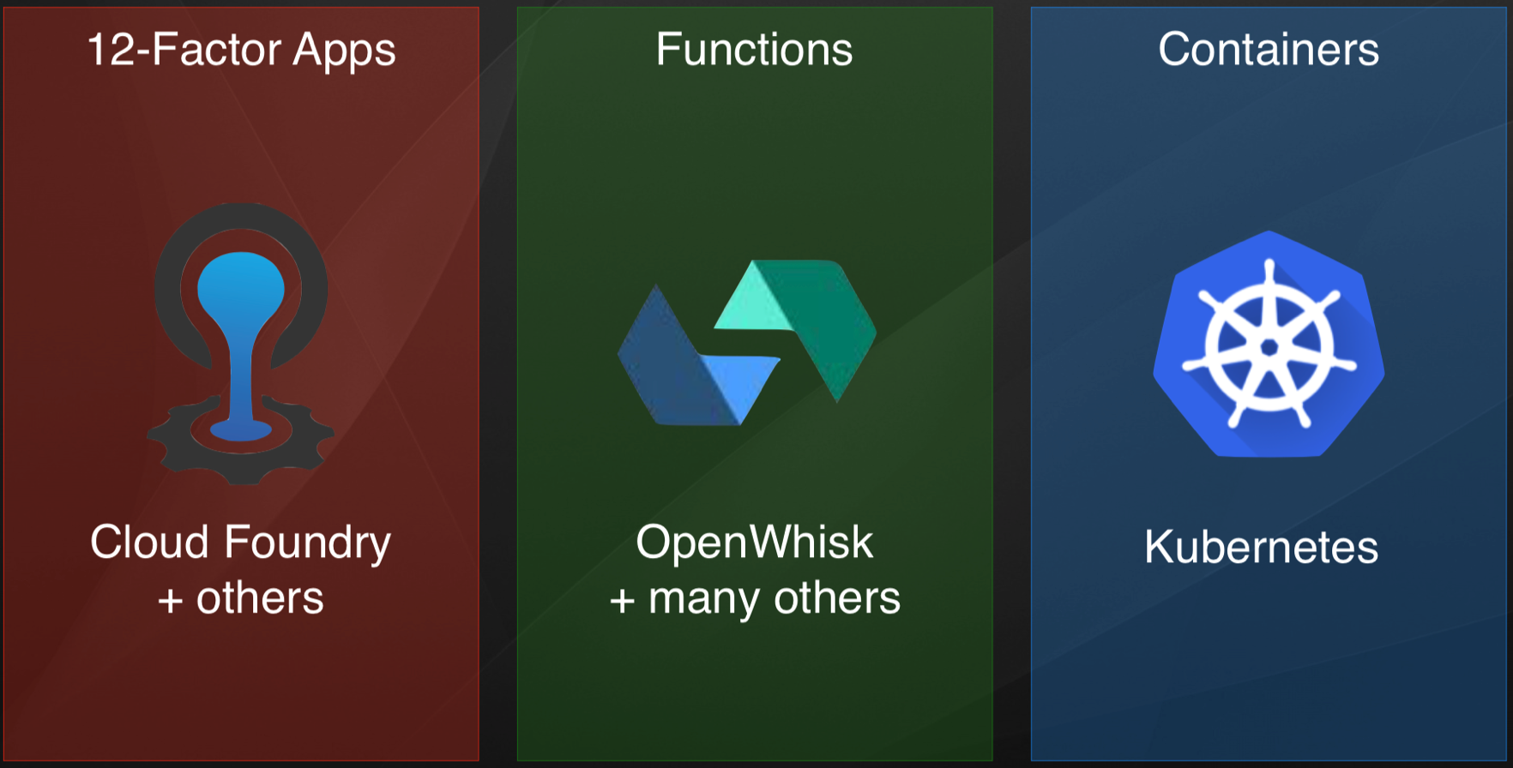

Recap
Session 1
What is Openshift ?
WebConsole
CLI
Resources Openshift
Cloud Pak for Applications (CP4A)
Session 2
Cloud Native Application - Why, What and How?
Cloud Native Runtimes and Frameworks on IBM Cloud Platform - CP4A

Slide 6
Deploy Applications to OpenShift
Deploy an application from an existing container image.
Build and deploy from source code contained in a Git repository using a Source-to-Image builder.
Build and deploy from source code contained in a Git repository from a Dockerfile.

Slide 7
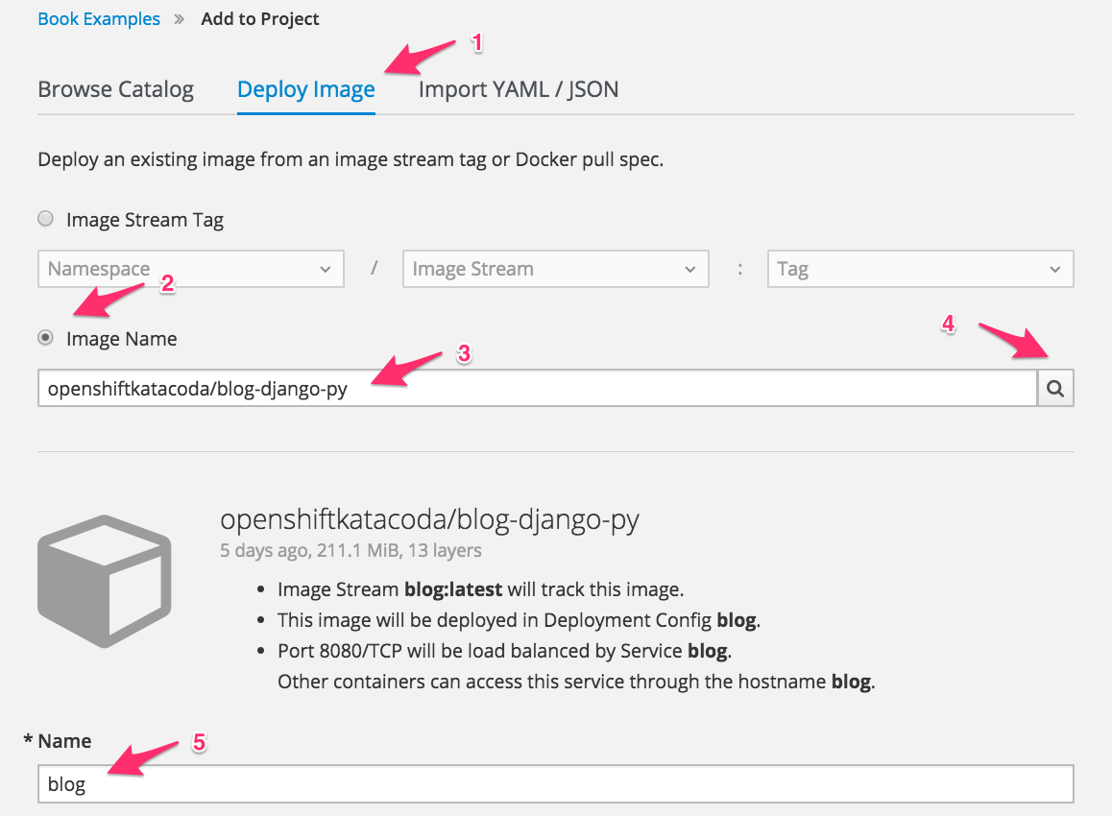
Deploy application image

Slide 8
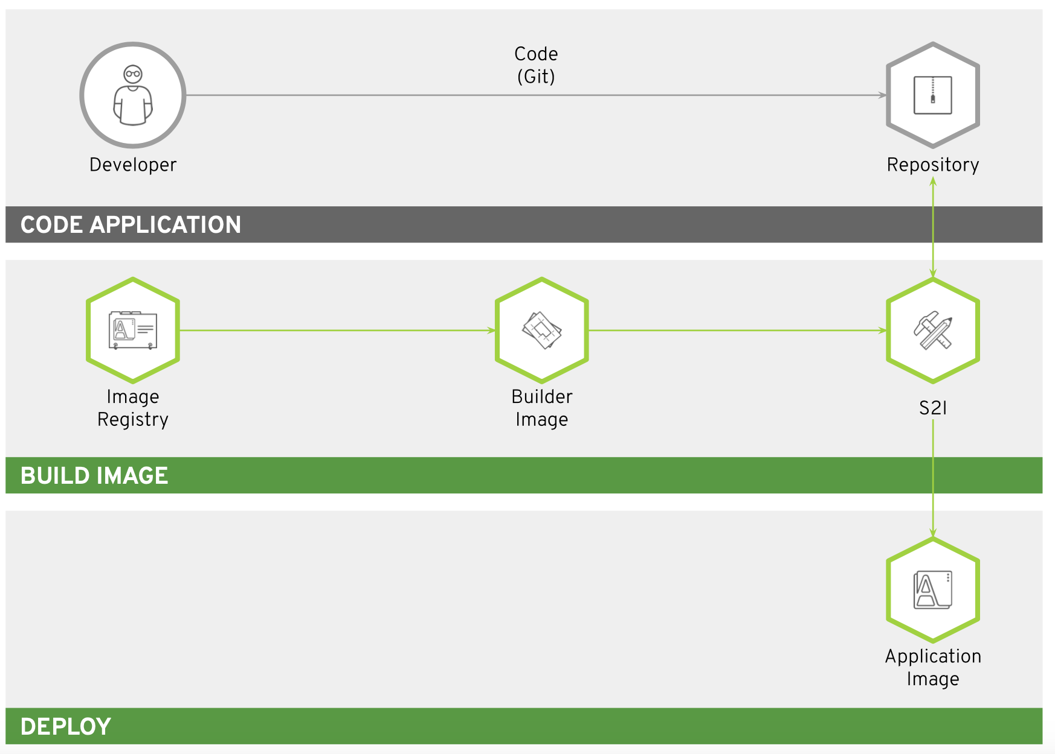
Building and Deploying from Source Source-to-Image - for building and deploying code

Slide 9
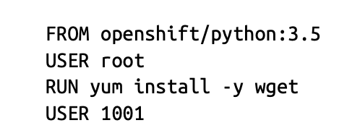
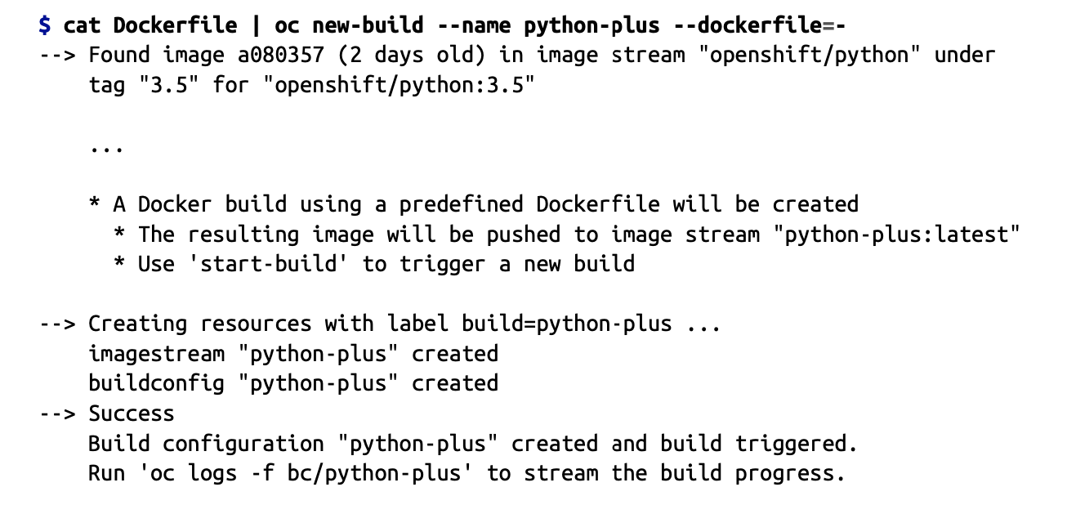
Building an Image from a Dockerfile Docker Build Strategy

Slide 10
Think of OpenShift deployment as a set of layers

Slide 11

OpenShift Deployment – Developer view
Layer 4: Abstractions
Services, routes, PVCs, secrets etc
Layer 3: Deployments
Defines what will run in OpenShift
Layer 2: Images
Images created by build layer
Build Tool
Image
Layer 1: Builds
Defines the builds required for the app
For e.g S2I, Cloud native build, etc
Layer 0: Base images
The base images used by the apps
For e.g node js

Slide 12
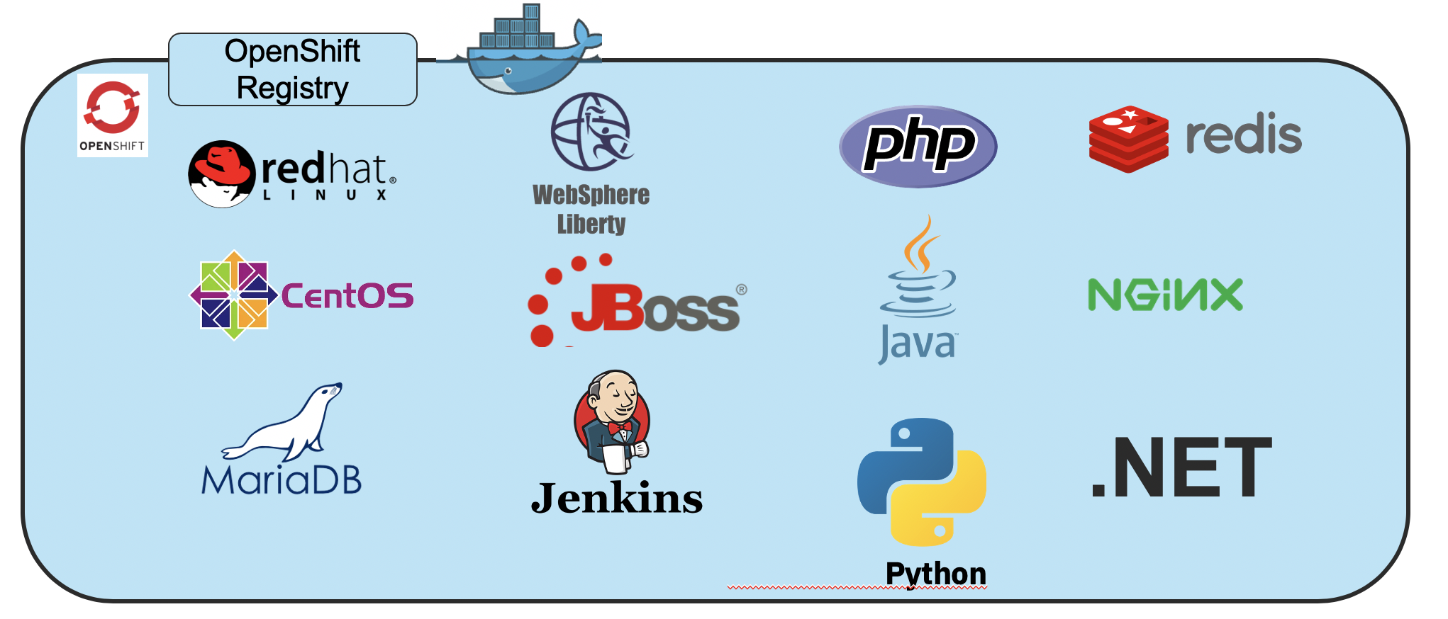
Layer 0 – Base image examples
Layer 4: Abstractions
Base operating systems, specific runtimes, databases, application servers and more
Available as Image Streams, an enhanced set of metadata about each image
Layer 3: Deployments
Layer 2: Images
Layer 1: Builds
Layer 0: Base images

Slide 13
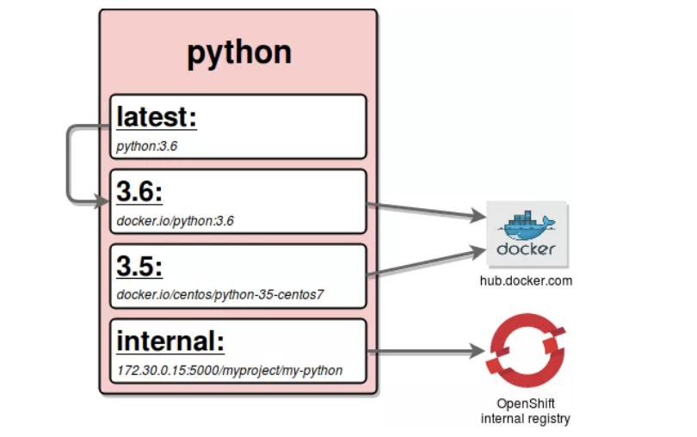
Image Streams
Image Stream example
An image stream represents one or more Docker images identified by tags.
Presents a single virtual view of related images
Can refer to images from any of the following:
Its own image repository in OpenShift’s integrated Docker Registry
Other image streams
Docker image repositories from external registries
Image Streams are trigger an event when underlying image is changed (even if tag remains the same)
Graphic source: https://blog.openshift.com/image-streams-faq/
Notes:
Example Image Stream referencing a Python image
Tags 3.5 and 3.6 reference images at Docker Hub
Tag internal references an image in the internal Open Shift registry
Tag latest refers to the Image Stream tag 3.6

Slide 14
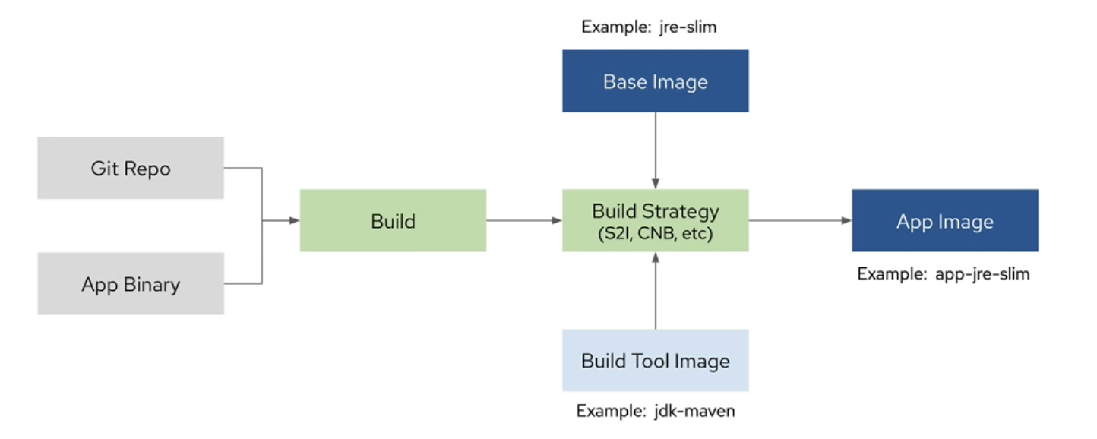
Level 1: Builds
Defined via a BuildConfig object
A blueprint for a process to transform base images + source code, app binaries, or
Dockerfiles to an app image:
Key attributes:
Input (input to the build process ) - e.g. file, directory, GH repo etc
Strategy (how to build the app image) -options
S2I – Use a specialized builder image to generate app image (more later)
Docker - Use a Docker file to generate app image
Pipeline - A Jenkins pipeline that generates the app image from source
Custom – Encapsulate your build process via a custom builder image
Output (result of the build process) – typically an ImageStream tag
Layer 4: Abstractions
Layer 3: Deployments
Layer 2: Images
Layer 1: Builds
Layer 0: Base images

Slide 15


Level 2: Images
Defined via an ImageStream object
An abstraction for working with Docker images inside OpenShift
Key attributes:
ImageStreamImage (reference to actual image) - typically not used directly
ImageStreamTag (reference to a given ImageStream and tag)
Layer 4: Abstractions
Layer 3: Deployments
Layer 2: Images
Layer 1: Builds
Key: ImageStreamImage
ImageStreamTag
Layer 0: Base images

Slide 16
Level 3: Deployments
Layer 4: Abstractions
Defined via a DeploymentConfig object
Encapsulates the K8s Deployment and adds deployment strategies and triggers
Key attributes:
Strategy (how to deploy if the underlying Deployment is already deployed) Options:
Recreate– Blow away old deployment first and then deploy new one
Rolling (default) – Zero downtime rollout via K8s RollingUpdate
Advanced - (Note: require routes)
Blue-Green
A/B
etc
Triggers (define conditions under which the deployment is automatically triggered)
e.g Input image updated, config changes
Layer 3: Deployments
Layer 2: Images
Layer 1: Builds
Layer 0: Base images

Slide 17
Level 4: Abstractions
Layer 4: Abstractions
Defines all of the additional resources needed for an app like networking, storage, security etc
Frequently used resources: (there are several others)
Service – Internal load balancer and router. Directs network traffic to replicated Pods
Route – Exposes a Service at a defined host name to allow access from external traffic
Persistent Volume Claim – Permanent storage used by apps to persist data after the
app has stopped running
Secret – Mechanism for holding sensitive data. Decouples sensitive data from the the
Pods that use them.
Layer 3: Deployments
Layer 2: Images
Layer 1: Builds
Layer 0: Base images

Slide 18


Deployment Controller
Container
Pod
Replication Controller
Deployment Controller
Notes:
Pod , scaling - replication controller – required no of replcias are running
Deployment - build on rc – with a dditional Appliaction Lifecycle management – Upgrades- Rollback- Application revisioning etc

Slide 19
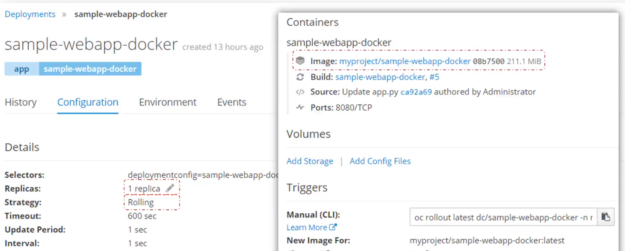
Deployment

Slide 20
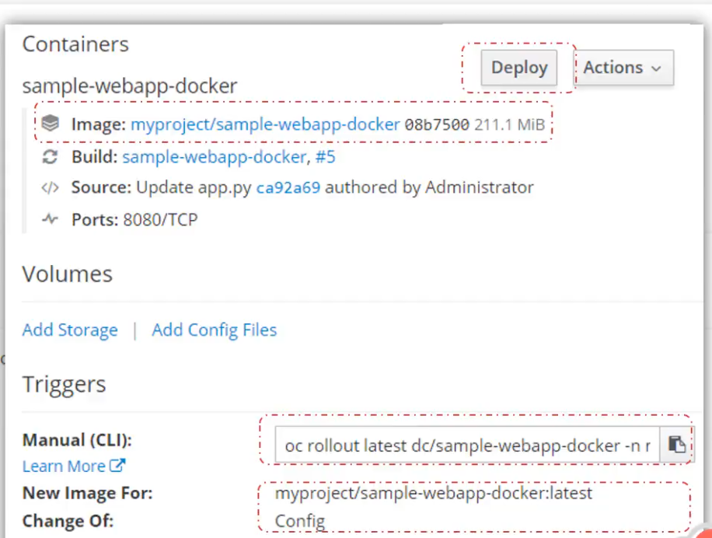
Deployment

Slide 21
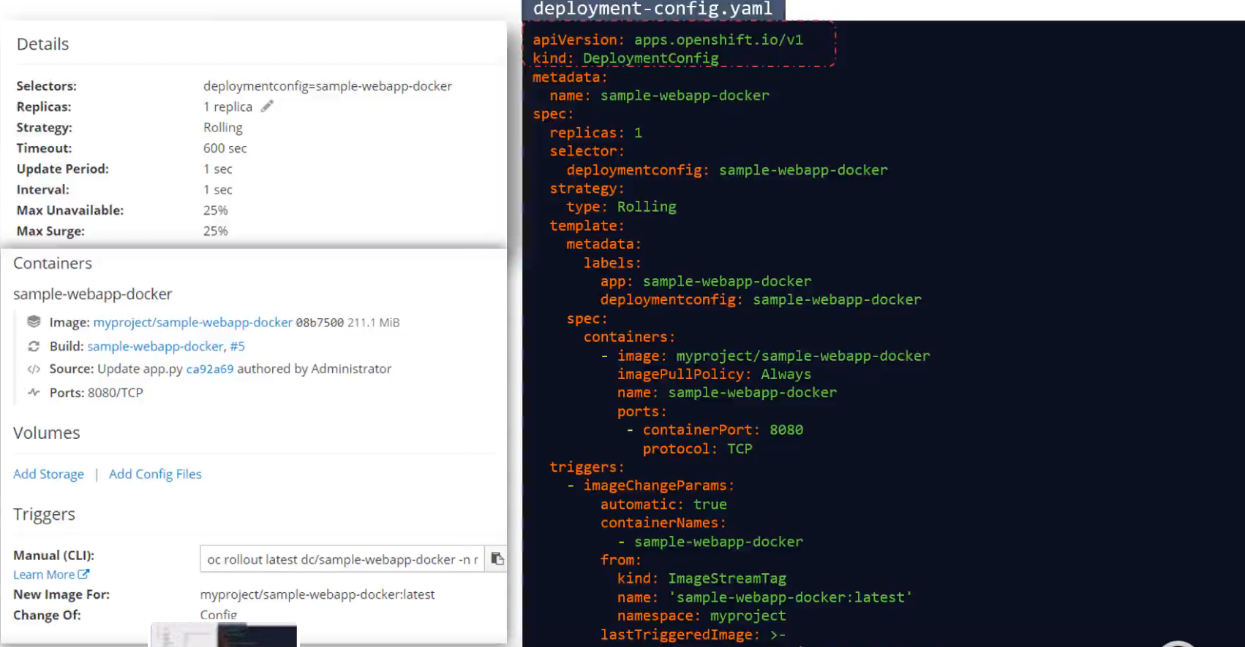
Deployment YAML

Slide 22
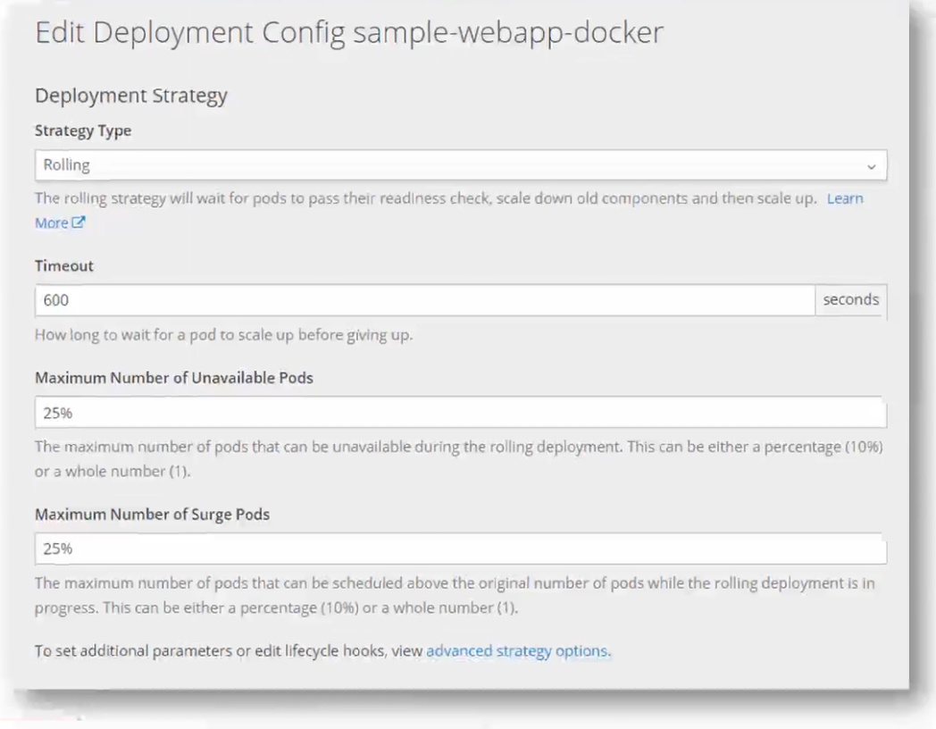
Edit Deployment Configuration

Slide 23
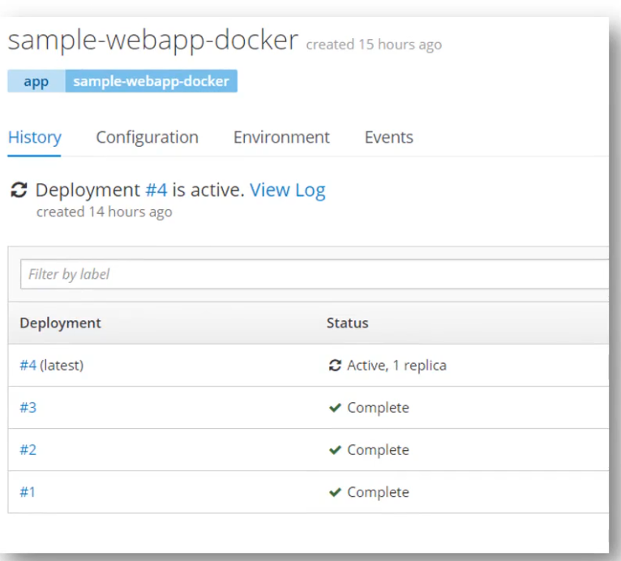
Deployment History

Slide 24
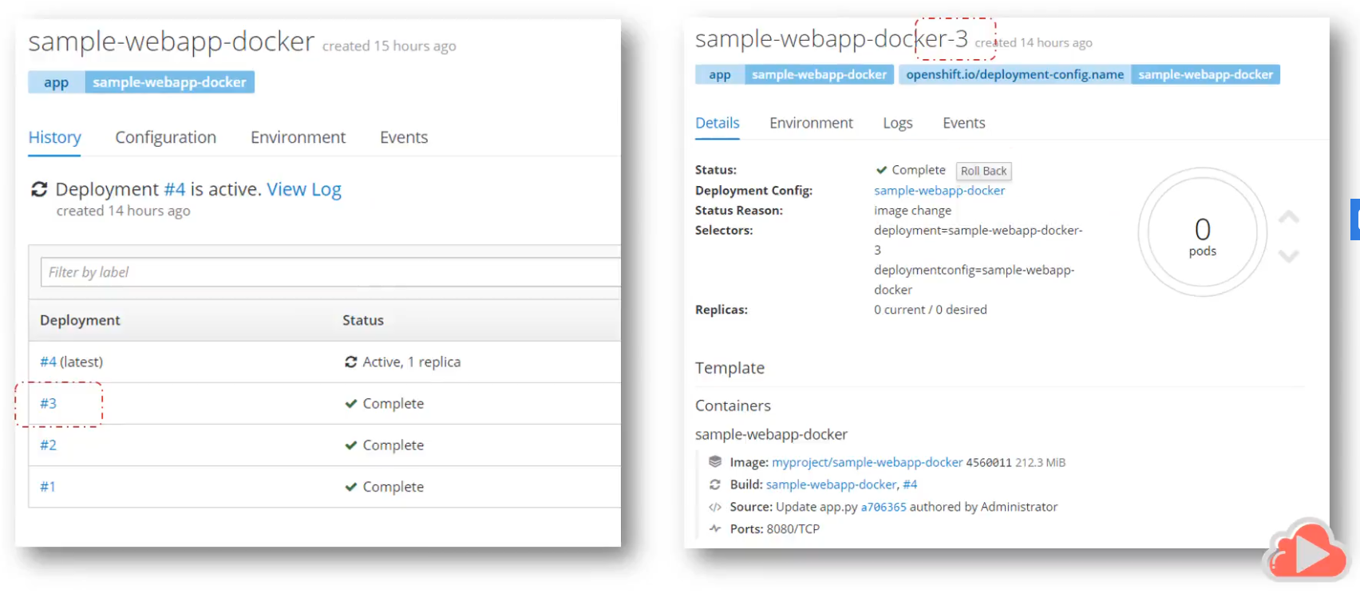
Rollback

Slide 25
Deployment Strategy – Why?
A way to change or upgrade an application.
The aim is to make the change without downtime
In a way that the user barely notices the improvements.
Things to consider - Define Deployment Strategy
Long running connections need to be handled gracefully.
Database conversions can get tricky and will need to be done and rolled back along with the application.
If the application is a hybrid of microservices and traditional components downtime may be needed to complete the transition.
You need the infrastructure to do this.
If you have a non-isolated test environment, you can break both new and old versions.

Slide 26
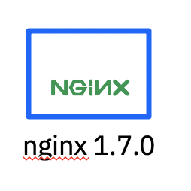
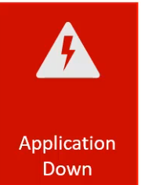
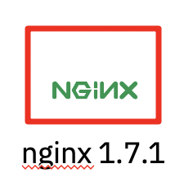
Deployment Strategies
Take down application and not want another version
Recreate
Rolling
Upgrade

Slide 27
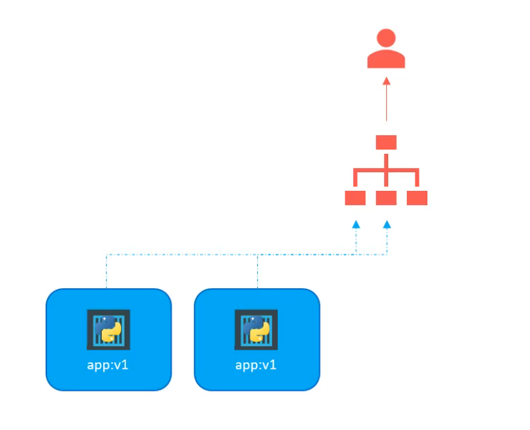
Advanced Strategies – Blue Green

Slide 28
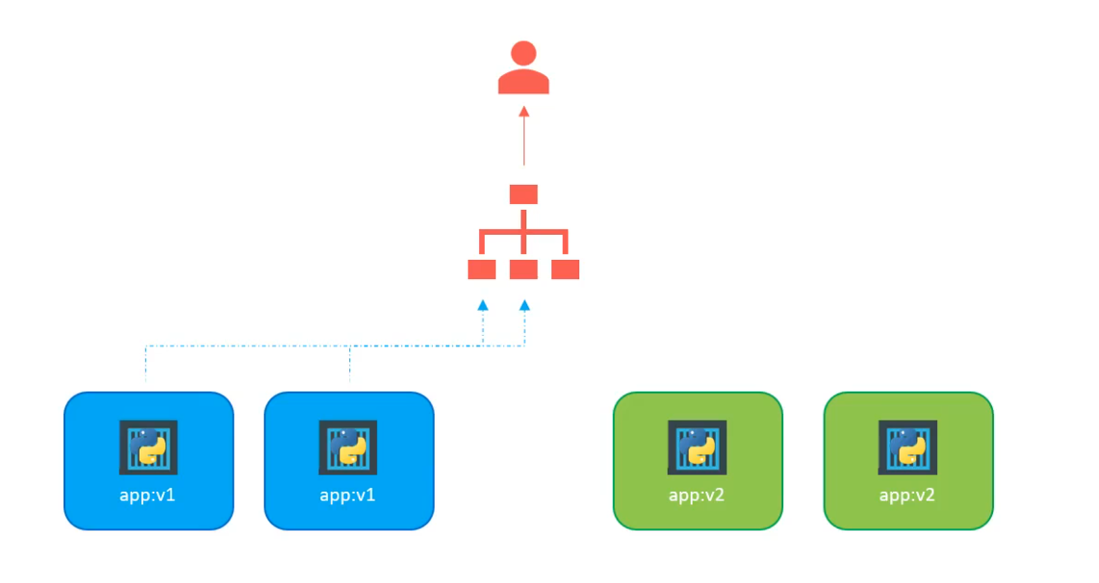
Advanced Strategies – Blue Green

Slide 29
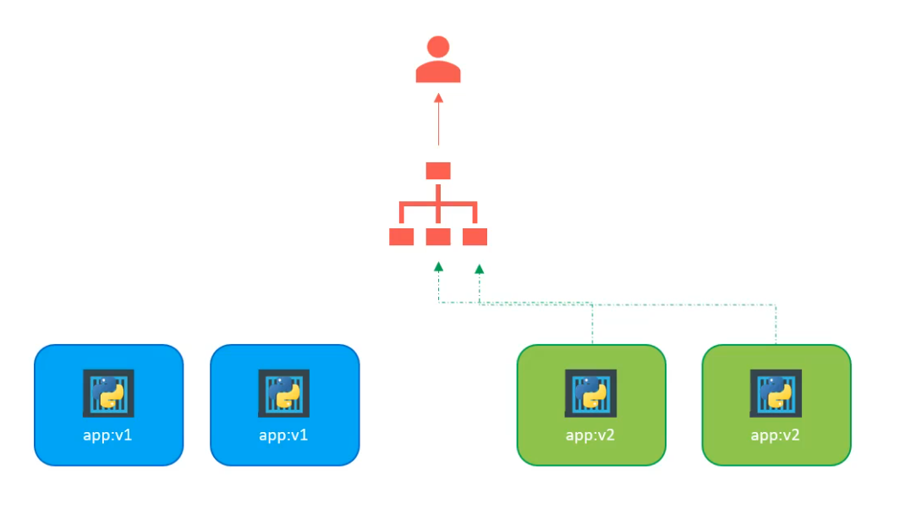
Advanced Strategies – Blue Green
The downside is that you need twice as many compute resources as your application actually needs.
So if your application requires two machines, you need four machines when you are running both deployments.

Slide 30
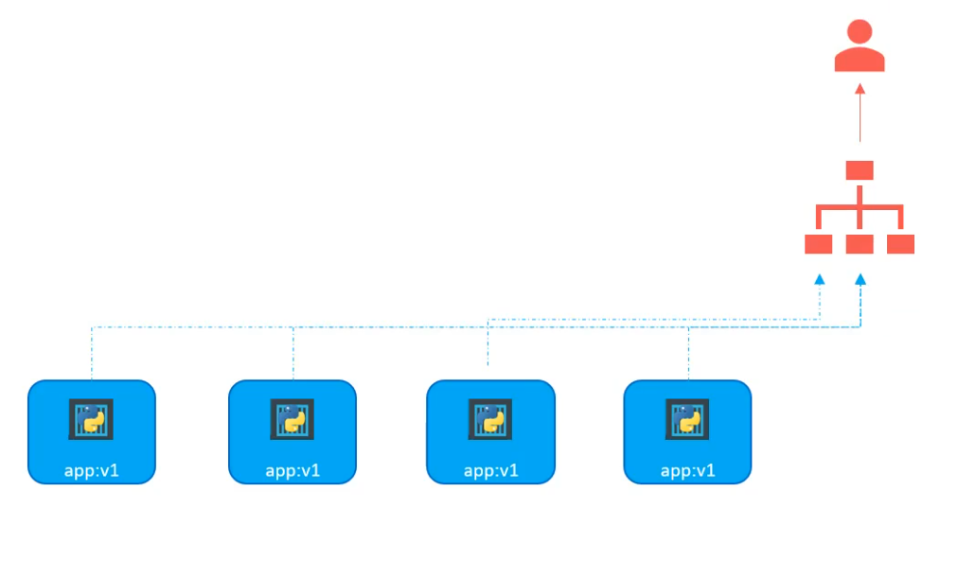
Advanced Strategies – A/B

Slide 31
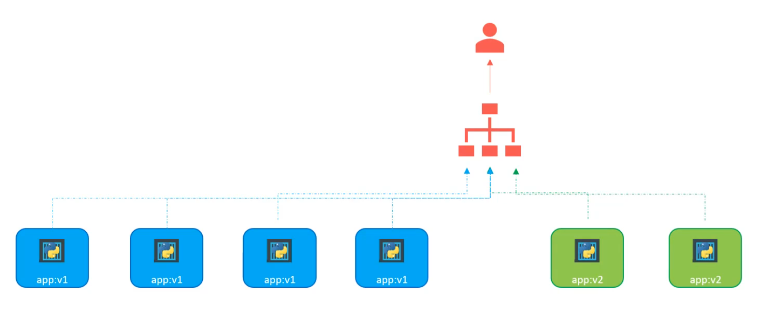
Advanced Strategies – A/B

Slide 32
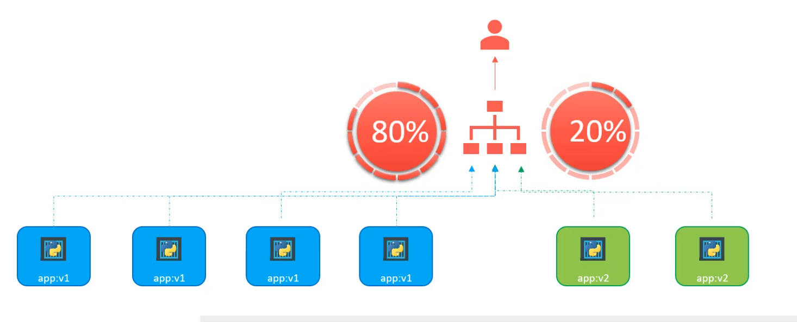
Advanced Strategies – A/B
Try a new version of the application in a limited way in the production environment

Slide 33
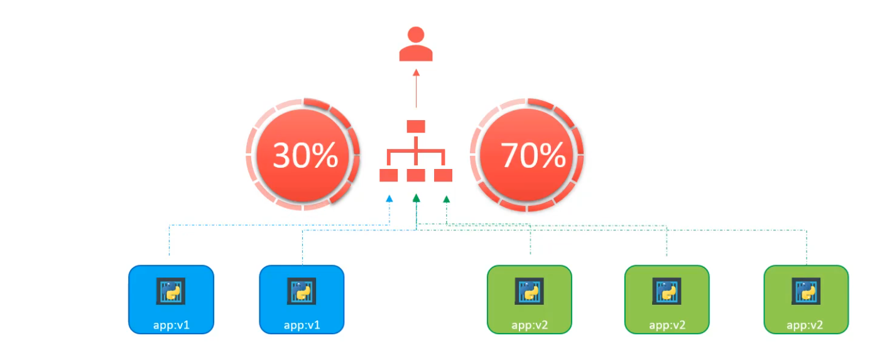
Advanced Strategies – A/B

Slide 34
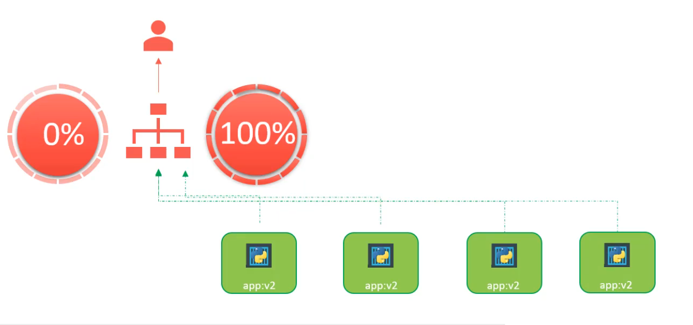
Advanced Strategies – A/B

Slide 35
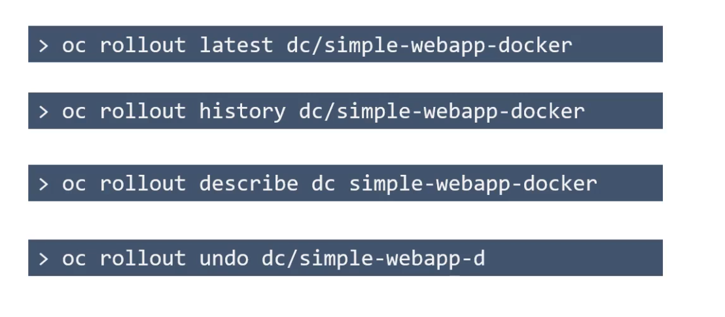
Commands

Slide 36

Demo Time!

Slide 37
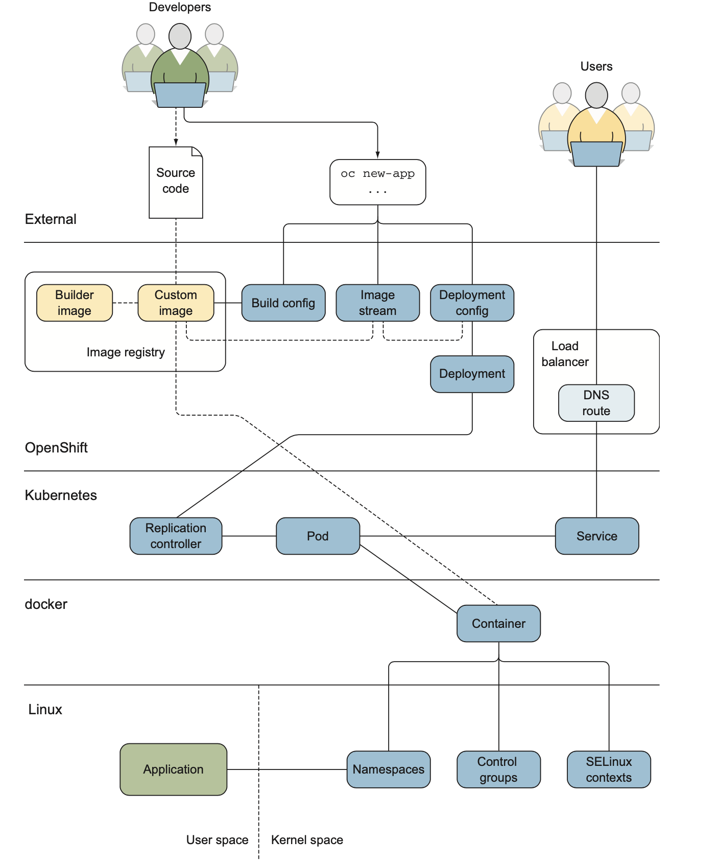
E2E

Slide 38

@MangeshPatank
/mdpatankar
in/mangesh-patankar
mapatank@in.ibm.com

Slide 39
Cloud Native Development-Using IBM Cloud Pak for Applications 10 min break
IBM Cloud Registration -
https://bit.ly/cloudreg12may
JOIN SLACK FOR SUPPORT –
https://bit.ly/infyslack
Already signed in Developers – Q&A Session channel link
https://bit.ly/slackinfosys

